Slide 1
Develop Universal
Windows Apps
on Windows 10
Ashish Sahu
Aparna Chinya
Windows AppConsult Engineer

Slide 2
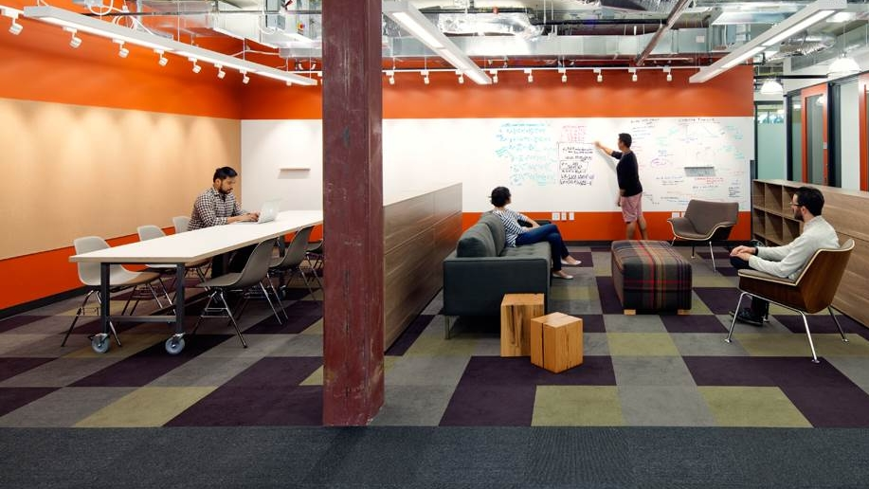
Agenda
Developing Adaptive Code for UWP Apps
Designing Adaptive UI and tailored design
Delighting the users
Bring your app alive with Cortana Voice Commands
Build connected apps with roaming application data
https://github.com/FutureUnleashed/HOL
http://1drv.ms/1GXxfg5

Slide 3
Agenda
Writing Adaptive Code for UWP Apps
Designing Adaptive UI and tailored design
Delighting the users
Bring your app alive with Cortana Voice Commands
Build connected apps with roaming application data

Slide 4
Developing Adaptive Code for UWP Apps
Getting started with Universal Windows Apps
Extension SDKs
Lab

Slide 5
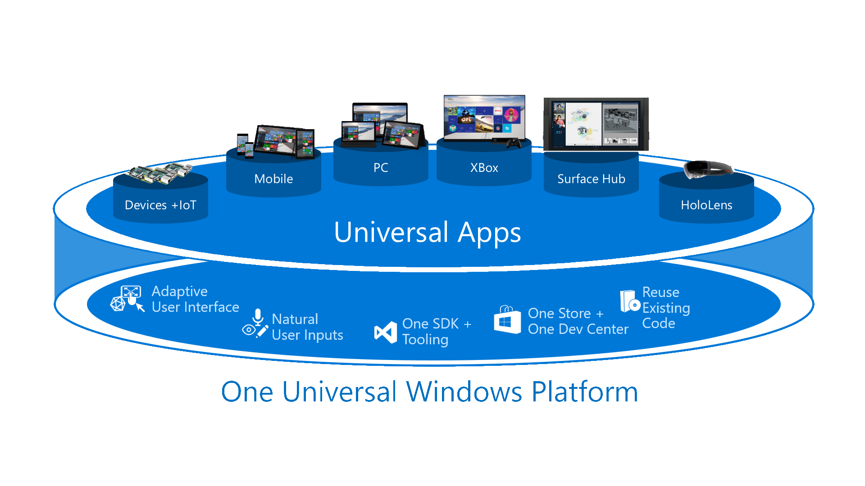

Slide 6
One Windows
Desktop family
Mobile family
Xbox family
IoT family
IoT headless family
Surface Hub family
Holographic family
PC
2 in 1
Tablet
Phablet
Phone
Xbox
Band
Raspberry Pi
Surface Hub
HoloLens
Home Automation
Band 2

Slide 7
Designing Adaptive UI and tailored design
Visual States
Adaptive Triggers
RelativePanel
Lab

Slide 8
Physical Pixel
Effective Pixel

Slide 9
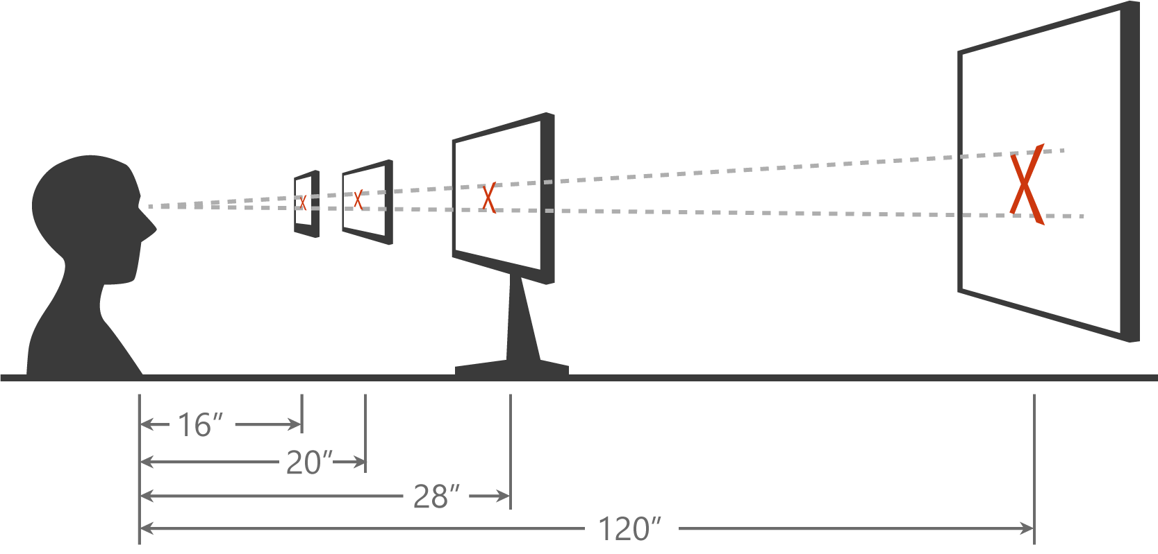

Slide 10
Delighting the users
Adaptive Tiles
Toast Notifications
Interactive Toasts
Context Menu
Background Tasks & Background transfers
Share Contracts
Lab

Slide 11
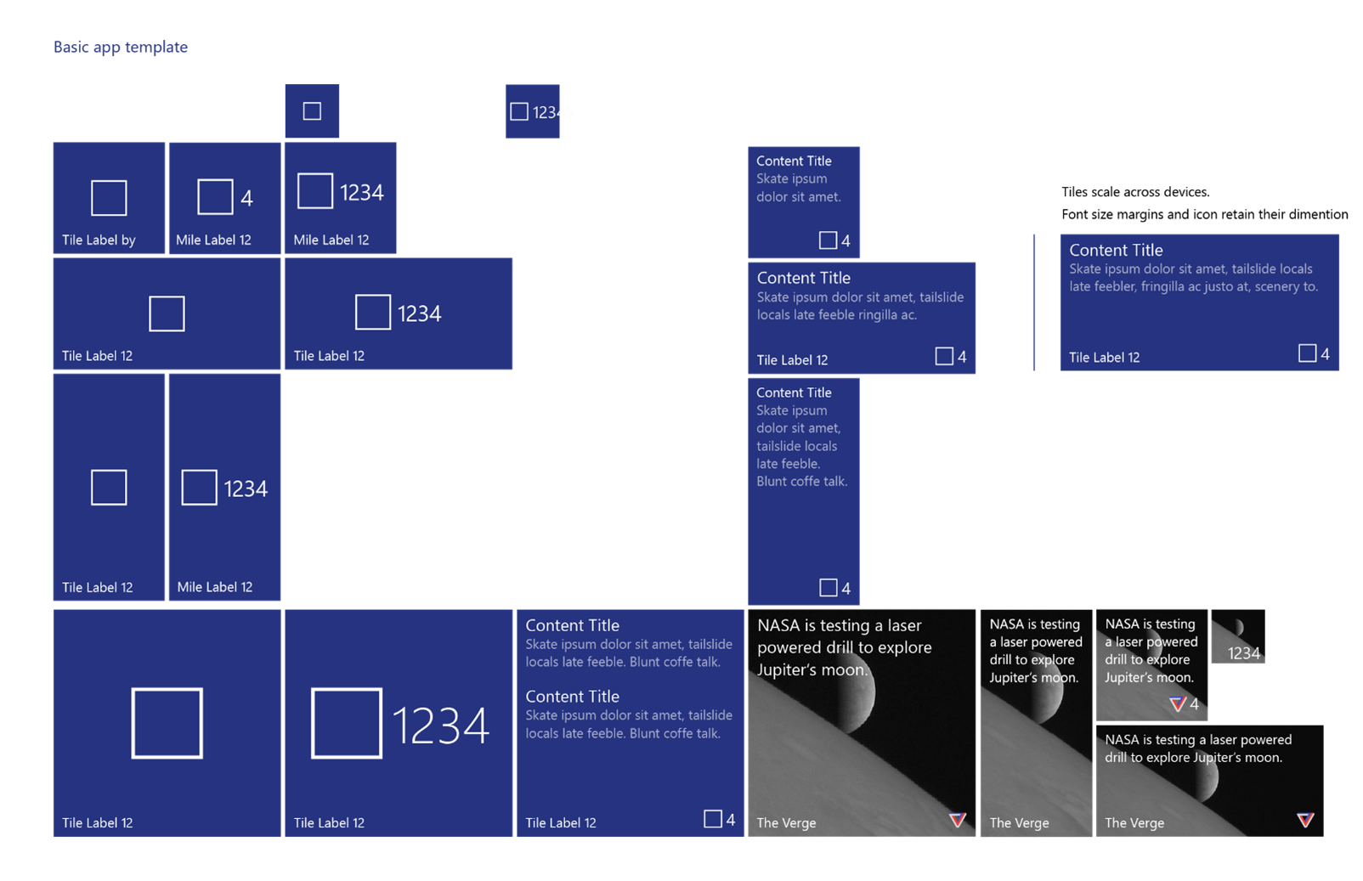

Slide 12


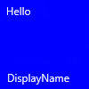

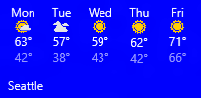
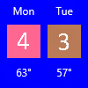
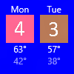


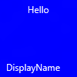

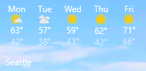
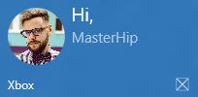


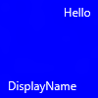

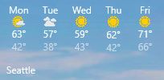
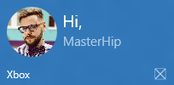


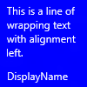
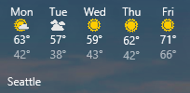


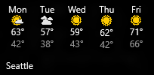
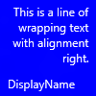

Slide 13
Cortana Voice Commands
Cortana is everywhere
Lab

Slide 14
Application Data & Settings
Application data
Roaming data across devices
Lab

Slide 15


References
Related references for you to expand your knowledge on the subject
http://aka.ms/NotificationsVisualizer
http://aka.ms/AdaptiveTiles
technet.microsoft.com/en-in
aka.ms/mva
msdn.microsoft.com/
Developer Network

Slide 16
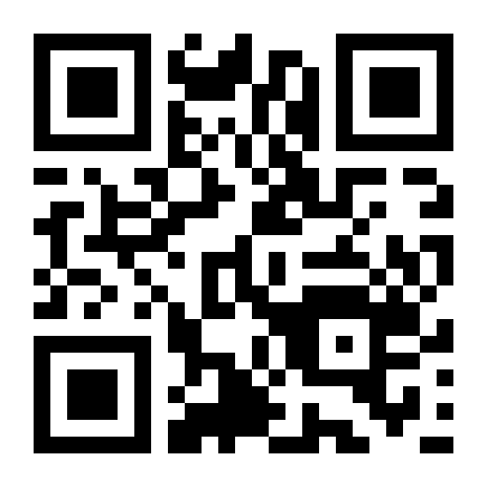
Tell us what you think
Help us shape future events by sharing your valuable feedback.
Scan the QR code to evaluate this session.

Slide 17

Thank you
Follow us online
Twitter:
@aparnachinya
Email: appconsultindia@microsoft.com

